Slide 1
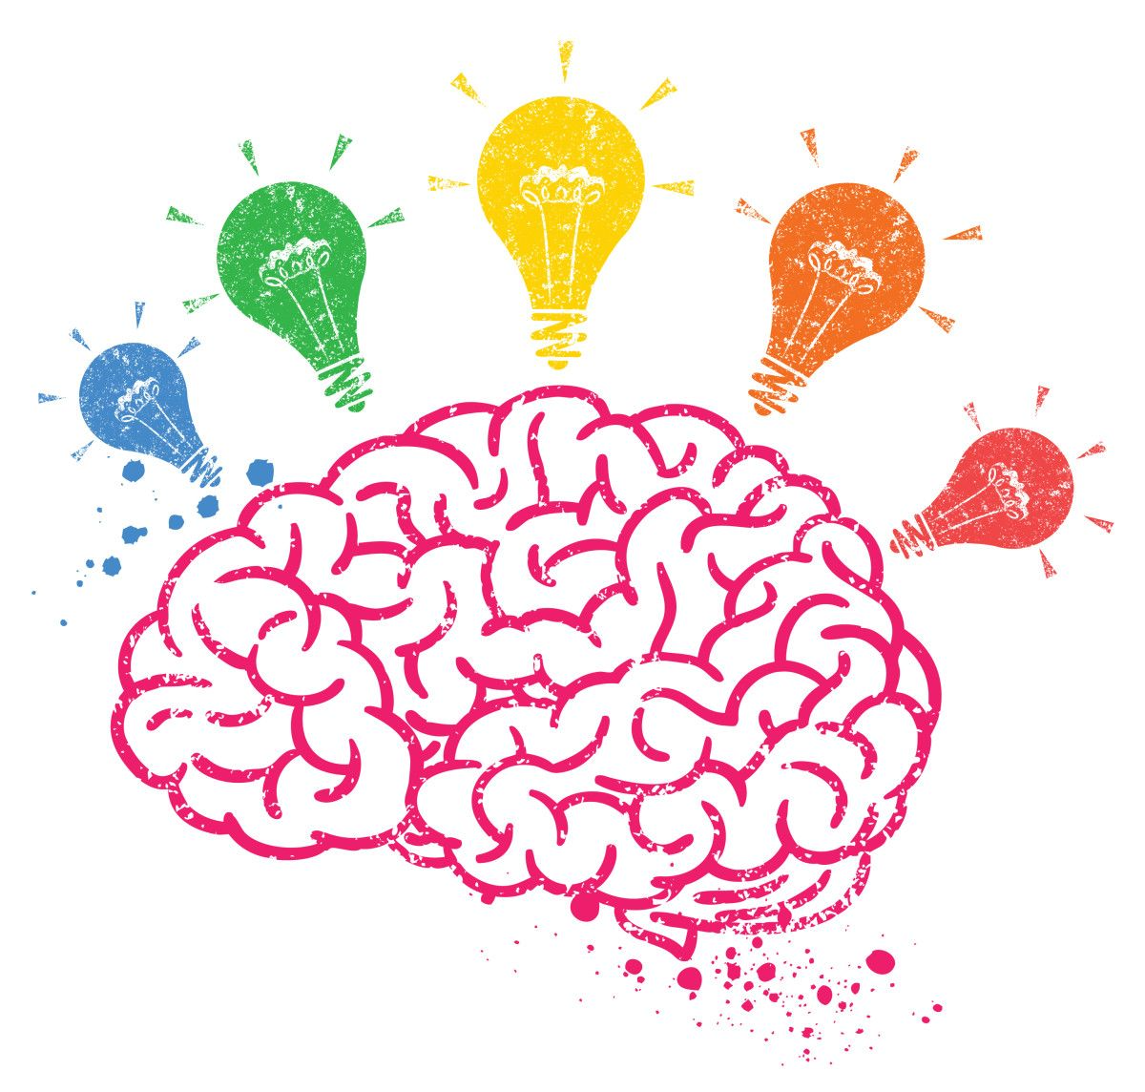
Welcome to the RSA Brainstorm
with Danny Zweben

Slide 2
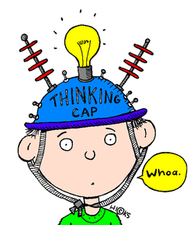
Today’s goal….. LEARN!
1. The task:
Learning From Evaluation And Recall of iNteractions task.
2. The approach:
Representational Similarity Analysis (RSA).
3. The brainstorm:
Our lab has not yet utilized RSA, so this is a chance to brainstorm the best way to implement it and generate meaningful hypotheses.

Slide 3

What is the LEARN Task?
Learn is a novel, fMRI paradigm where adolescents interact with peers and receive social feedback.
Each of these peers differ in disposition (nice vs mean) and predictability (predictable vs unpredictable).
A uniquely redesigned version of the Virtual School Task, built to test how social learning unfolds through peer feedback, cognitive-neural mechanisms, and across social anxiety symptoms.

Slide 4
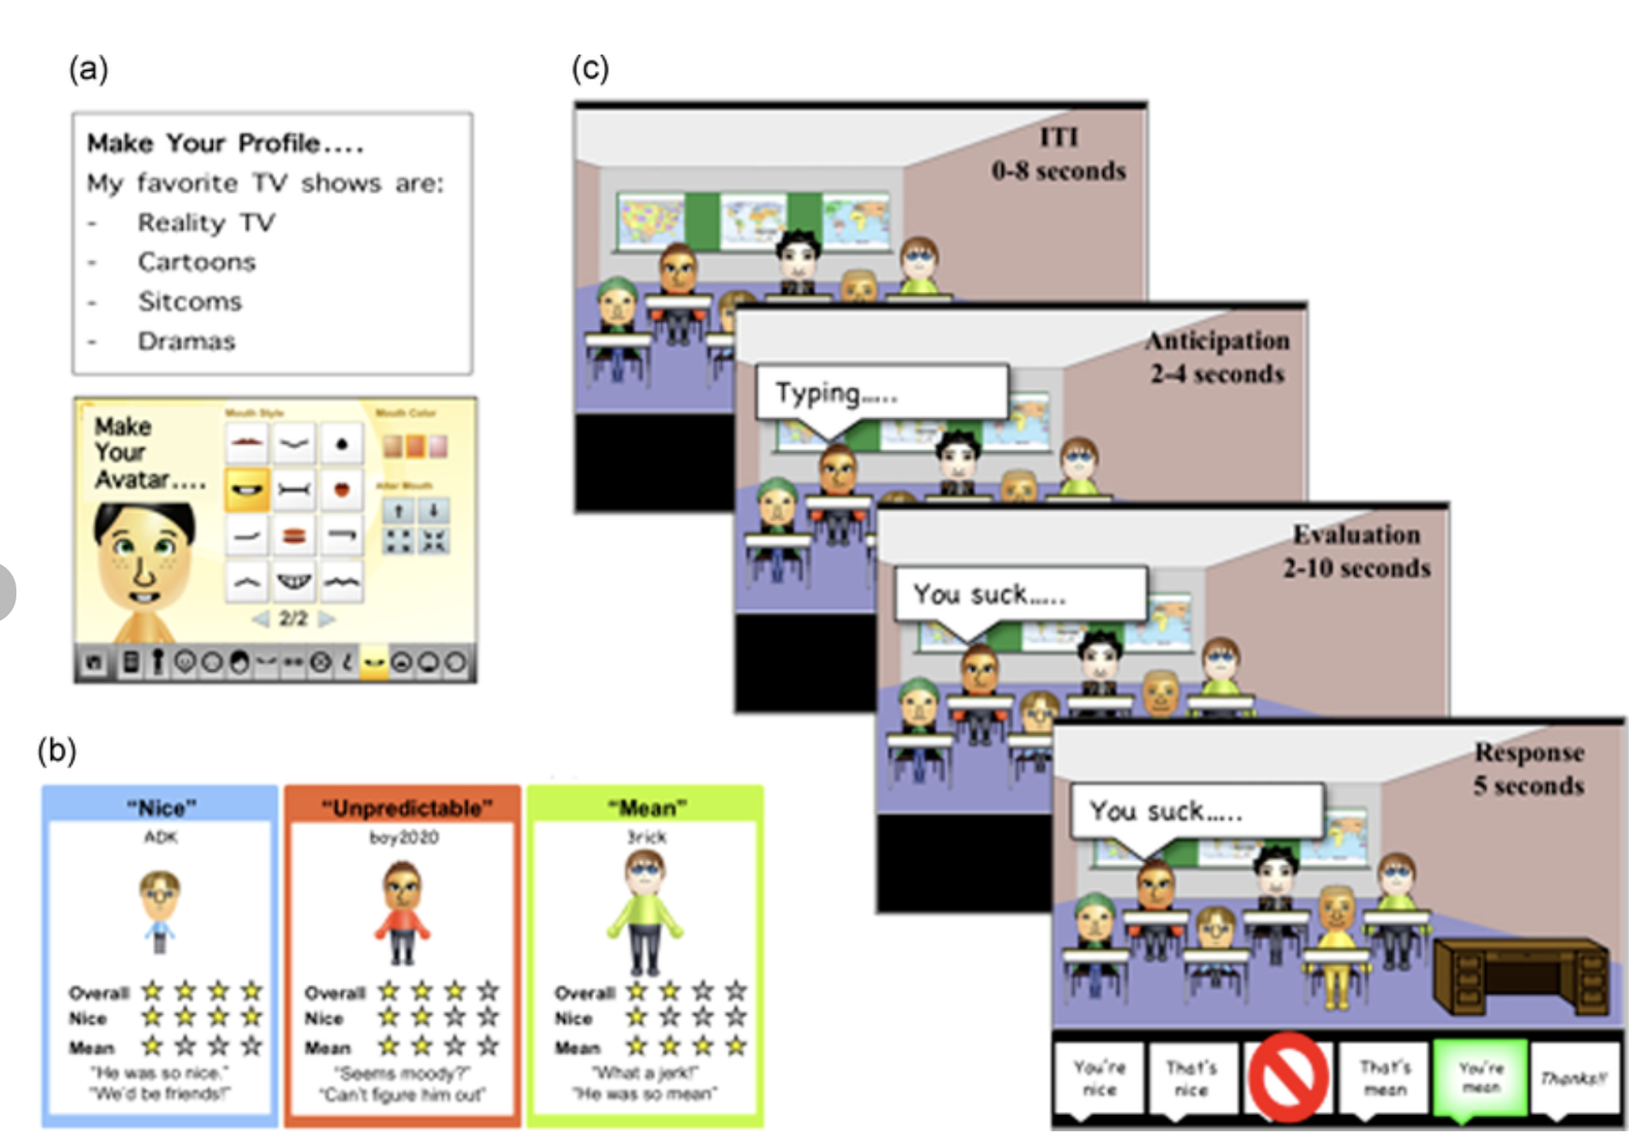
Reminder: Virtual School Task:
Participants create an avatar/profile and are introduced to six preprogrammed peers. They learn about 6 peers and are told which are nice (always positive), mean (always negative), or unpredictable (50/50).
They enter the scanner, the virtual school…and then interact 12 times with each peer.
A peer’s avatar appears with a “typing…” cue (anticipation of feedback).
The peer delivers a comment (positive or negative, consistent with their reputation).
The participant selects a response (positive, negative, sarcastic, or avoidant), which is shown back to the peer.
Design goal: Models anticipation and receipt of predictable vs. unpredictable social evaluation, while capturing real-time social responses.

Slide 5
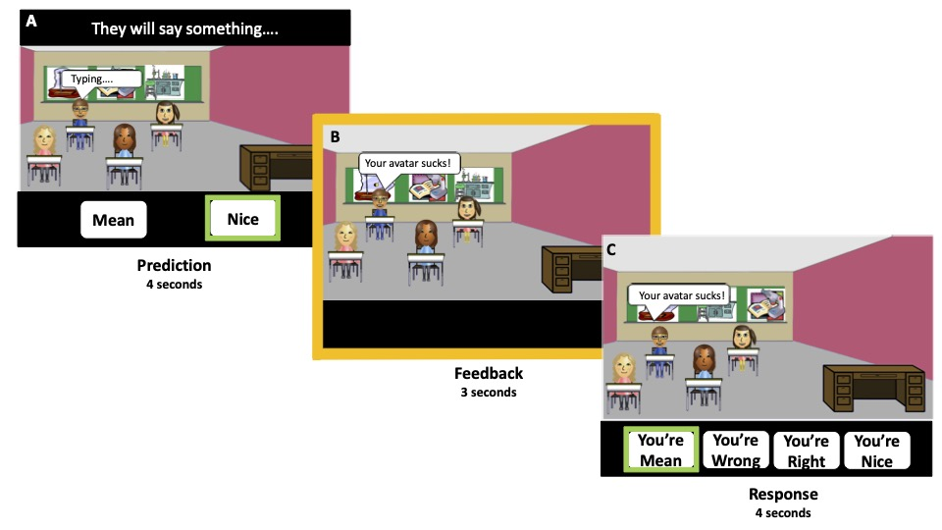
What’s new in LEARN?
In LEARN, adolescents interact with four virtual peers inside the scanner. Unlike in VST, peers’ reputations are not told.
Instead, participants have the chance to figure them out through repeated feedback.
Each trial begins with an explicit prediction about a peer’s behavior, followed by social feedback that can confirm or violate expectations.
With 128 total trials (4 peers × 32 each), the task is dense enough to model prediction errors, learning rates, and other dynamics of social learning.

Slide 6
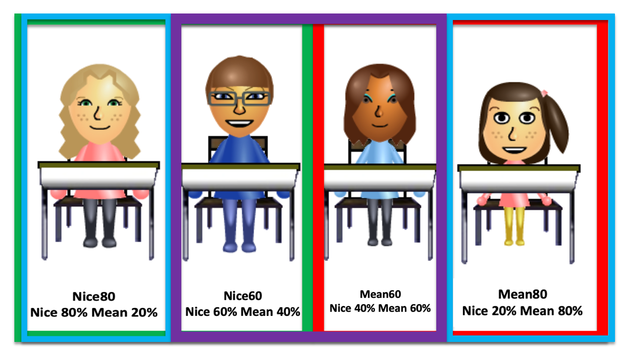
LEARN: methodology
The peers:

Slide 7
LEARN: methodology
Classroom / Run Structure
Participants completed 4 classrooms (runs)
Each run lasted about 6:30 minutes.
In every classroom, they interacted with the same 4 peers, 8 times each.
Each trial had three epochs:
1. Prediction (4s): Participant predicts whether the peer will be nice or mean.
2. Feedback (3s): Peer provides feedback (positive or negative).
Confirms or disconfirms the prediction.
3. Response (4s): Participant responds with:
“You’re Right”
“You’re Wrong”
“You’re Nice”
“You’re Mean”
Inter-Trial Interval (0.5s)…..next prediction….
Peer interactions
The order of peer appearances was interaction with each peer appeared 8 times per run.
Order of peers held constant across participants.

Slide 8
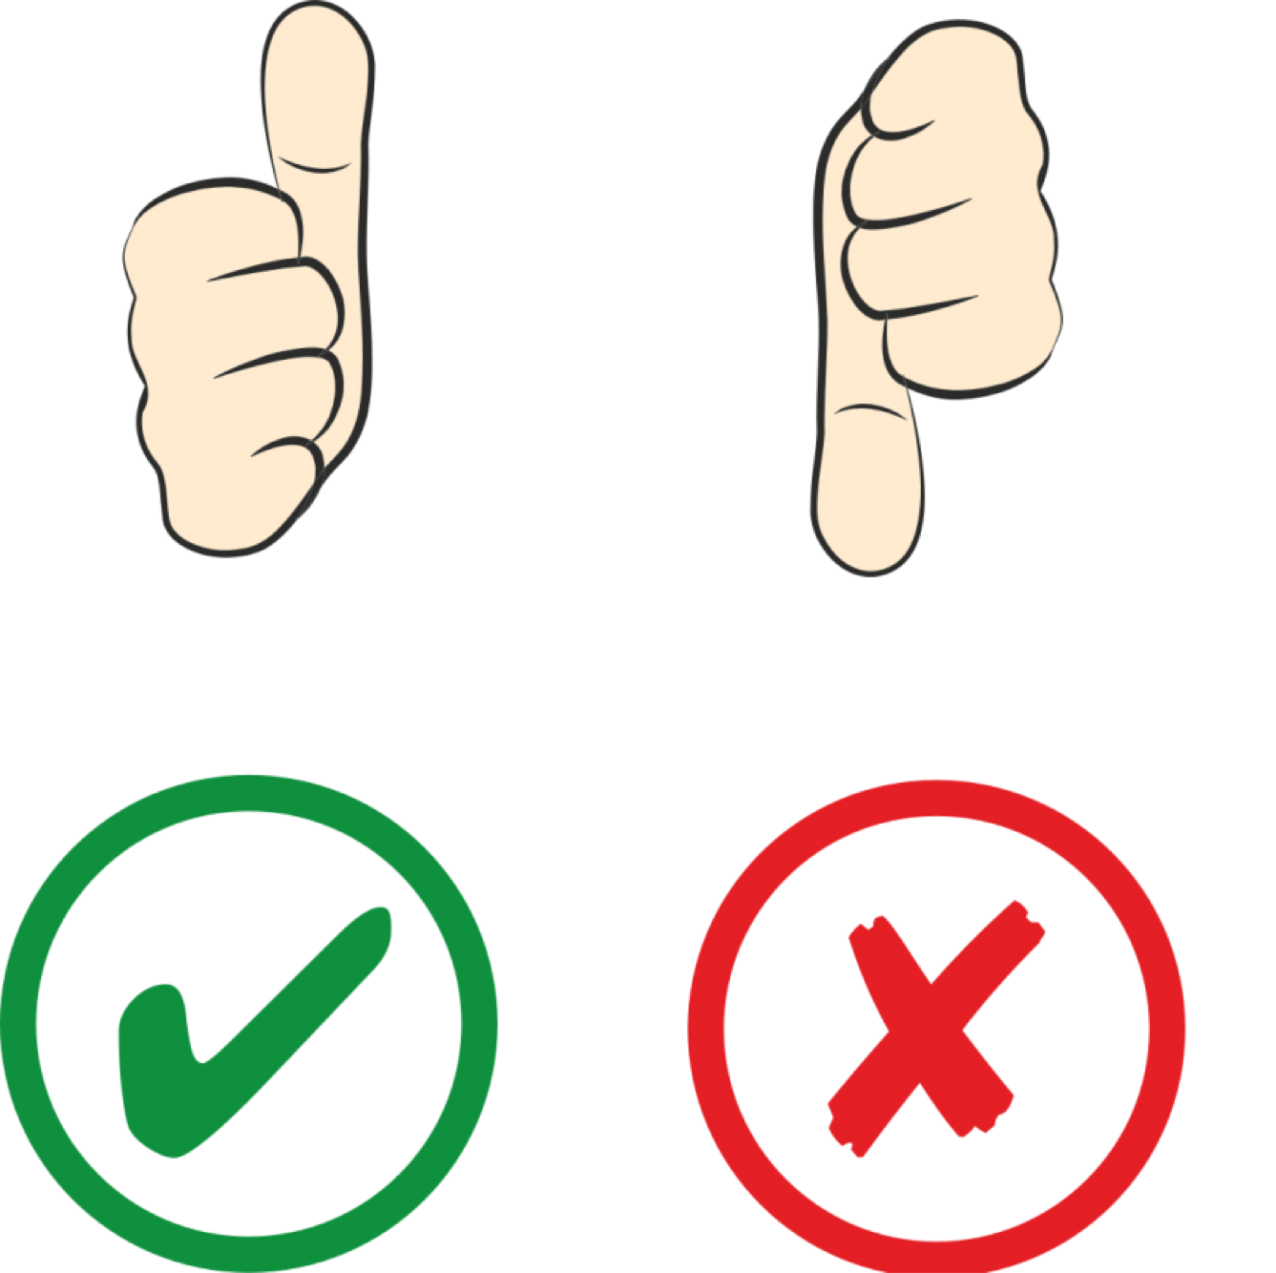
Trial Outcomes in LEARN
LEARN has 4 Trial Outcomes:
Correct predictions (no Prediction Error):
1. Predicted Nice → Got Nice → Accurate, Positive feedback
2. Predicted Mean → Got Mean → Accurate, Negative feedback
Incorrect predictions (Prediction Errors):
3. Predicted Nice → Got Mean → Negative Prediction Error
4. Predicted Mean → Got Nice → Positive Prediction Error

Slide 9

Trial Outcomes in LEARN
But prediction may not just be about accuracy – it’s about reputation
Correct predictions (no Prediction Error):
1. Nice REPUTATION → Got Nice → Accurate, Positive feedback
2. Mean REPUTATION → Got Mean → Accurate, Negative feedback
Incorrect predictions (Prediction Errors):
3. Nice REPUTATION → Got Mean → Negative Prediction Error
4. Mean REPUTATION → Got Nice → Positive Prediction Error

Slide 10
Sample in LEARN
47 adolescents, ages 10–15 years (mean ≈ 12.5, ~53% female.), recruited from the community and the Child and Adolescent Anxiety Disorders Clinic (CAADC) at Temple University
Subsample for fMRI + modeling: 33 youth (after exclusions).
SA grouping: Participants scoring ≥ 7 on the SCARED-SA subscale were categorized as Clinical SA; 21 youth (45%) met this criterion.

Slide 11
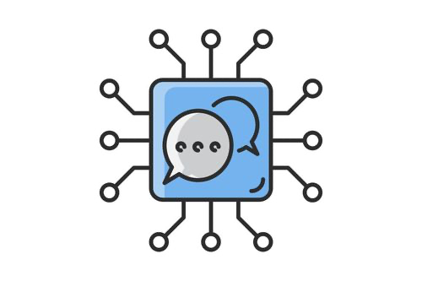
What we’ve LEARNED so far.
Learning Model:
Best fit: Reinforcement (updated based on being right vs. wrong) / associability (adjusting learning rate based on surprising feedback)
Social Anxiety was associated with…
Sharper/faster adjustments after any prediction errors, and a faster learning rate.
More emphasis on negative prediction errors than positive ones.
(Chloe: please help explain if they have questions)

Slide 12
Neural Results
Across all ROIs (vmPFC, dACC, anterior insula, posterior insula), accuracy-based prediction errors did not predict neural activation, nor did activation differ by social anxiety severity.
2. Instead, reputation-based PEs showed effects that varied with SA severity × peer disposition × predictability × feedback valence.

Slide 13
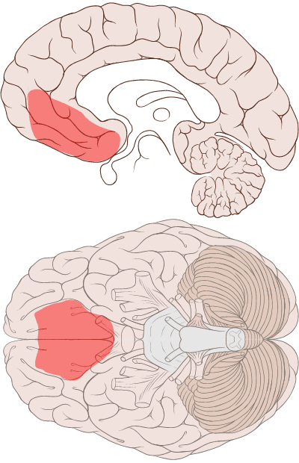
Neural Results: vmPFC
In the vmPFC (bilateral) SA was associated with…
In predictable peers:
1. Decreased response to negative PEs from predictably nice peers
(people don’t like me anyway ☹)
2. Increased response to positive PEs from predictably mean peers (omg, maybe they do like me!)
In unpredictable peers:
Decreased response to negative PEs from unpredictably mean peers (ONLY in vmPFC)
No reliable effects were reported for unpredictably nice peers

Slide 14
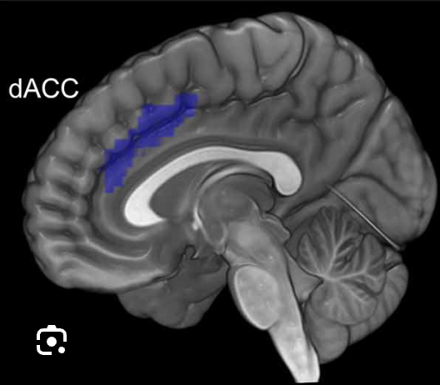
Neural Results: dACC
In the dAAC SA was associated with…
In predictable peers: (Same pattern as vmPFC)
1. Decreased response to negative PEs from predictably nice peers
2. Increased response to positive PEs from predictably mean peers
In unpredictable peers:
No consistent SA-by-PE effects

Slide 15
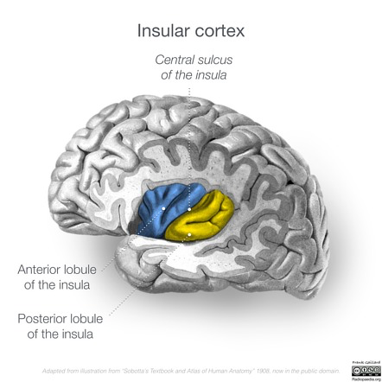
Neural Results: Anterior Insula
In the Anterior insula SA was associated with…
In predictable peers: (Same pattern again!)
1. Decreased response to negative PEs from predictably nice peers
2. Increased response to positive PEs from predictably mean peers
In unpredictable peers:
No consistent SA-by-PE effects

Slide 16
Neural Results: Posterior Insula
In the Posterior insula SA was associated with…
In predictable peers: (Same pattern again!)
1. Decreased response to negative PEs from predictably nice peers
2. Increased response to positive PEs from predictably mean peers
In unpredictable peers:
No consistent SA-by-PE effects

Slide 17
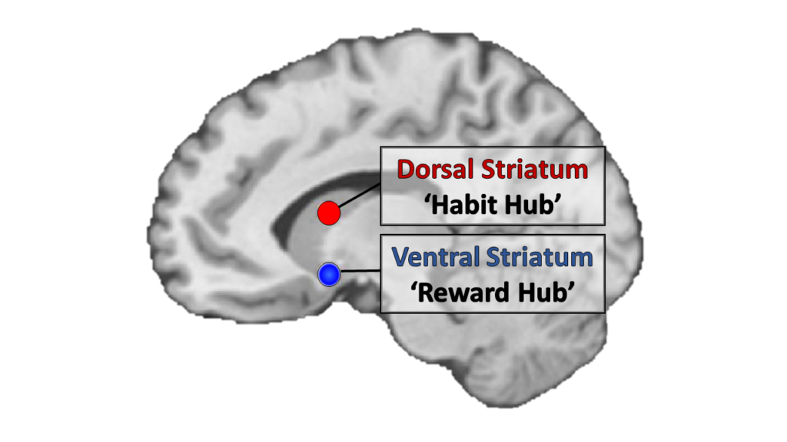
Neural Results: Ventral Straitun
In the Ventral Striatum SA was associated with…
You guessed it!
In predictable peers: (Same pattern again!)
1. Decreased response to negative PEs from predictably nice peers
2. Increased response to positive PEs from predictably mean peers
In unpredictable peers:
No consistent SA-by-PE effects

Slide 18
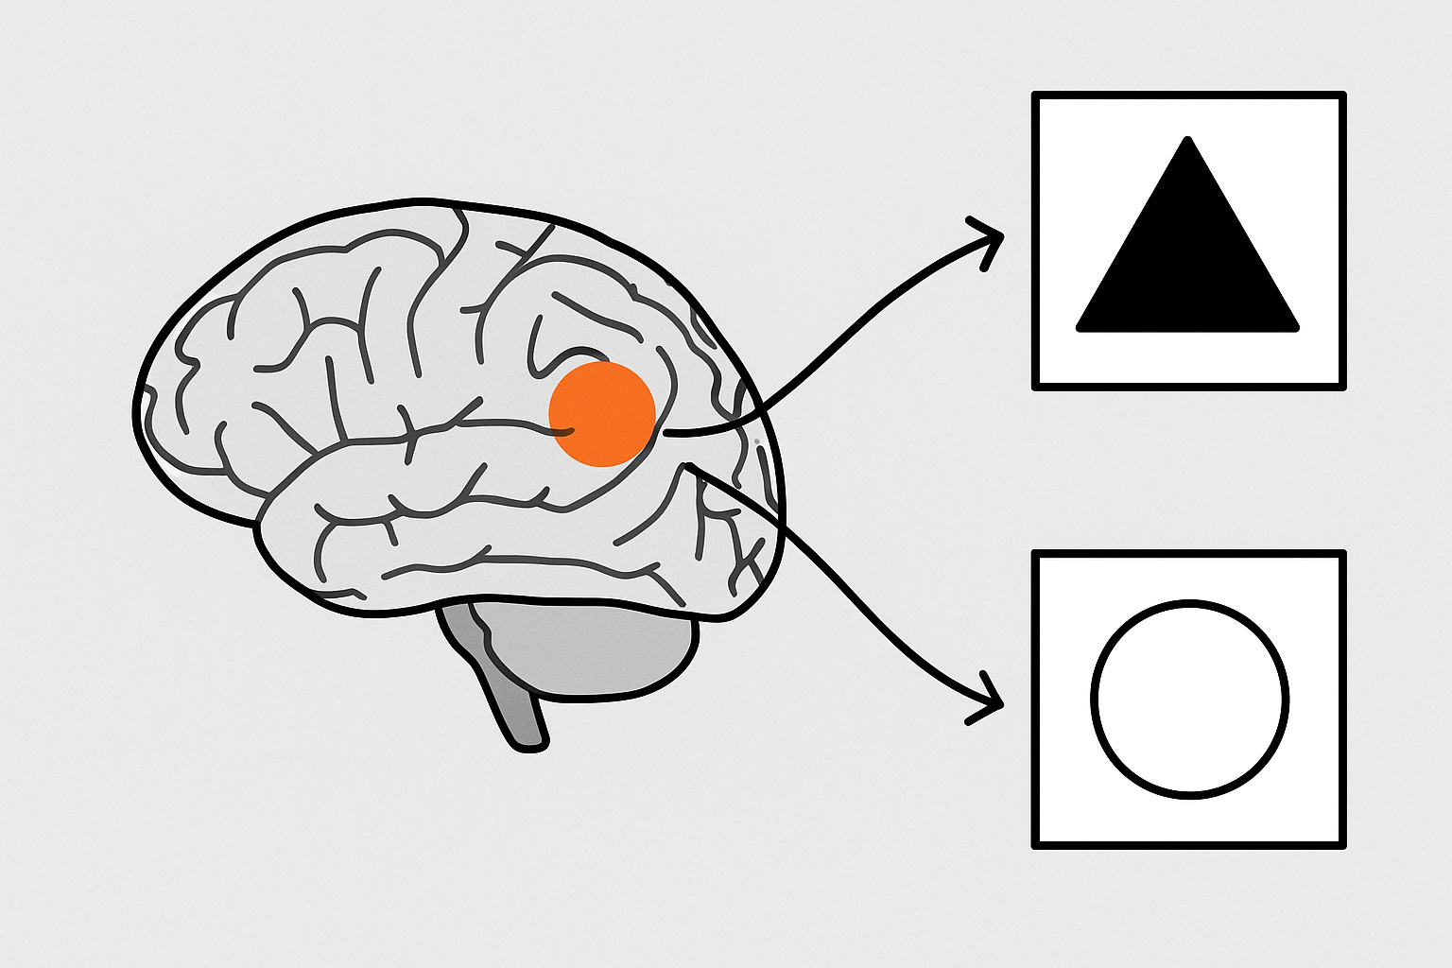
So what is RSA??
Representational Similarity Analysis:
RSA compares the patterns of brain activity between different stimuli or conditions.
Instead of asking “how strong is the response in the amygdala?” it asks…
“How similar or different are is the amygdala’s patterns across stimuli?”
“How does the brain group or separate different kinds of information?”
Cool things about RSA:
Can be applied to multiple brain regions at once (sometimes a whole network), or particular structure/region.
You can compare the brain’s patterns of grouping stimuli between participants in different conditions.
You can just look at the brain’s similarity structure, or compare it to a model (e.g., behavioral ratings, task structure, computational variables) to see if the brain organizes things the same way people behave or the theory predicts.

Slide 19
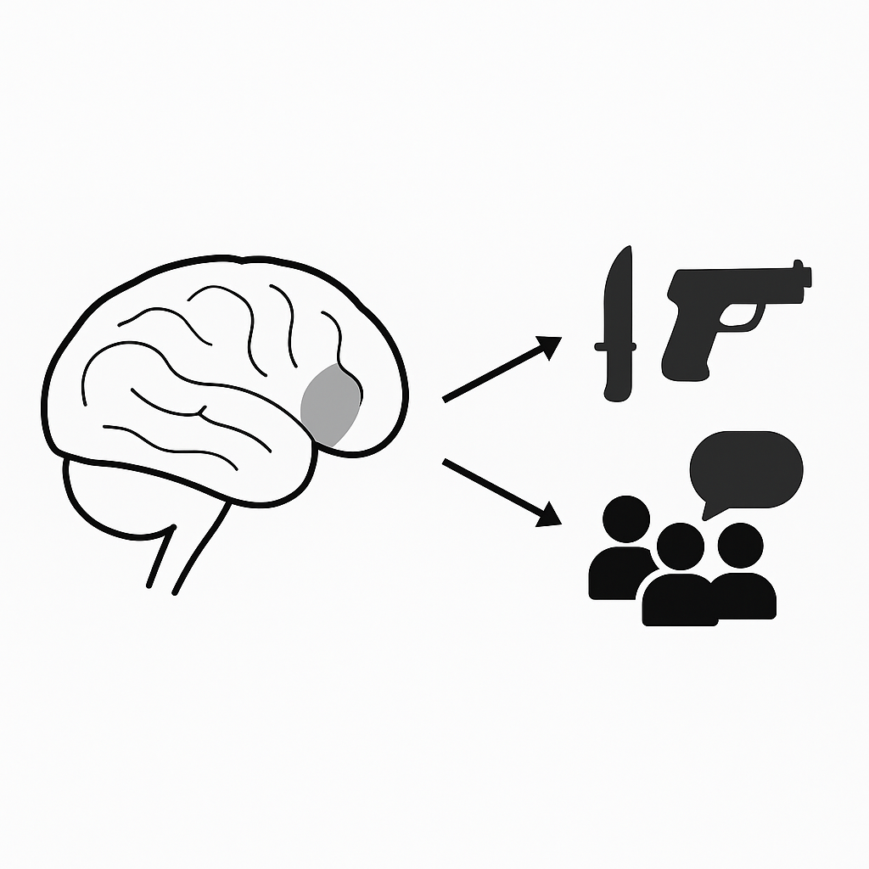
So what is RSA??
Silly Example to illustrate using RSA to inform models of behavior/cognition…
Model: SA = heightened threat, fight or flight during social interactions compare to non-SA
Social Anxiety
No Social Anxiety

Slide 20
I have one idea….
RSA Hypotheses: how are peers grouped?
Model RDMs (Representational Dissimilarity Matrix)
Disposition RDM: peers cluster by valence → nice together, mean together.
Predictability RDM: peers cluster by volatility → predictable together, unpredictable together.
Negativity RDM: mean peers cluster strongly, regardless of predictability; nice peers less distinct.
Predictions by SA severity
Lower SA youth: neural RDMs align more with Disposition RDM (positivity bias, balanced nice vs mean).
Higher SA youth: neural RDMs align more with Negativity RDM (negativity bias) or Predictability RDM (overweighting volatility).

Slide 21
My idea….operationalized
For each peer (e.g., Nice–Predictable, Nice–Unpredictable, Mean–Predictable, Mean–Unpredictable), average multivoxel patterns across their 32 trials.
This gives one neural pattern per peer.
Compare those peer-level patterns to each other → build a brain RDM.
Test alignment of the brain RDM with the model RDMs (Disposition, Predictability, Negativity).
Compare alignments between SA and non SA

